Slide 1


HACETTEPE UNIVERSITY
CMP601-SEMINAR
UNDERSTANDING
ANDROID MALWARE
Can you draw its image ?
Refik Can ÖZTAŞ - n23131610

Slide 2


Problem Statement
Context
With the increasing reliance on mobile devices for personal and professional activities, the security of Android devices has become critically important. Android, being the most widely used mobile operating system, has become a prime target for malware attacks. These malicious software programs can steal sensitive information, damage the device, or disrupt user activities.
Problem
Android malware poses a significant threat to the security and privacy of users. Despite ongoing efforts to enhance security, the volume and sophistication of malware attacks continue to grow. This is exacerbated by the open nature of the Android platform, the proliferation of third-party app stores, and the lack of timely security updates on many devices.

Slide 3

Analyzing Android Malware
### Code Analysis
- Reverse Engineering
- Control Flow Analysis
- Data Flow Analysis
### Behavioral Analysis
- File System Changes
- Registry/Preferences Modifications
- Persistence Mechanisms
### Network Analysis
- DNS Requests
- HTTP/HTTPS Traffic
- Command and Control
### Static Analysis
- APK File Extraction
- Manifest File Review
- Code Analysis
- Resource Analysis
- Certificate Analysis
### Dynamic Analysis
- Sandbox Environment
- Behavior Monitoring
- Network Traffic Analysis
- System Call Monitoring

Slide 4

Android Malware Challanges
Manual Feature Extraction
Obfuscation and Encryption
01
02
Malware can evade detection through techniques like code obfuscation, packing, and polymorphic behavior.
Involves decompiling APKs, analyzing code, and identifying features manually.
Dynamic Analysis Limitations
Static Analysis Challenges
03
04
Execution in sandbox environments can be time-consuming and resource-intensive, with malware potentially hiding its behavior.
Complex Code Structures: Modern Android applications can have complex structures, including multi-threading, extensive use of native code (via JNI), and dynamic code loading. Analyzing these structures statically is challenging.

Slide 5
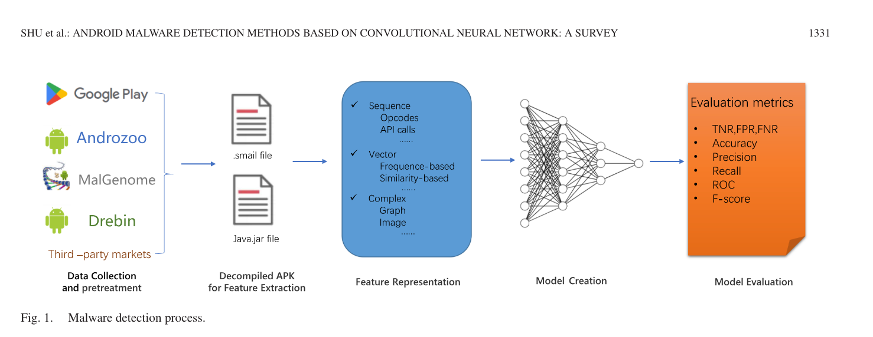

Slide 6


Solution is CNN
Why CNN Is a Good SolutIon for Malware DetectIon?

Slide 7
Solution is CNN
Automated Feature Learning
End-to-End Learning: CNNs can learn directly from raw data, eliminating the need for manual feature engineering.
Layered Architecture: Initial layers learn low-level features (e.g., byte sequences, n-grams), while deeper layers capture high-level features (e.g., structural patterns in code).
Hierarchical Representation: This hierarchical learning process enables CNNs to automatically discover complex patterns that are indicative of malware.
Reference: "Deep android malware detection," McLaughlin et al., 2017.

Slide 8
Solution is CNN
Robustness to Evasion Techniques
Obfuscation Resilience: CNNs can identify underlying patterns in obfuscated or packed code that are not affected by superficial changes.
Visual Pattern Recognition: Converting bytecode to images allows CNNs to recognize visual patterns that remain consistent despite code obfuscation.
Reference: "Android malware detection method based on bytecode image," Ding et al., 2020.

Slide 9
Solution is CNN
Scalability and Efficiency
Large-Scale Data Handling: CNNs are designed to process large volumes of data efficiently, making them suitable for analyzing extensive malware datasets.
Parallel Processing: Leveraging GPU acceleration enables faster training and inference times, critical for real-time malware detection.
Reference: "Malware detection by eating a whole exe," Raff et al., 2018.

Slide 10
Solution is CNN
Flexibility and Adaptability
Multiple Input Modalities: CNNs can process various types of input data, including bytecode images, opcode sequences, and hybrid feature representations.
Adaptive Learning: Capable of continuously learning and adapting to new types of malware as more data becomes available.
Reference: "Evaluating convolutional neural networks for effective mobile malware detection," Martinelli et al., 2017.

Slide 11
Solution is CNN
Explainability and Interpretability
Activation Mapping: Techniques such as Grad-CAM and LIME can be used to visualize which parts of the input data the CNN focuses on for making decisions.
Trust and Compliance: Enhances trust in the model's predictions and meets legal requirements for explainable AI in cybersecurity.
Reference: "Why should I trust you? Explaining the predictions of any classifier," Ribeiro et al., 2016.

Slide 12
Solution is CNN
Research and Development Insights
Novel Architectures: Advanced architectures like CNN-RNN hybrids can further enhance detection by capturing temporal dependencies in malware behavior.
Data Augmentation: Techniques like data augmentation and synthetic data generation improve model robustness and generalization.
Reference: "Towards Explainable CNNs for Android Malware Detection," Kinkead et al., 2021.

Slide 13

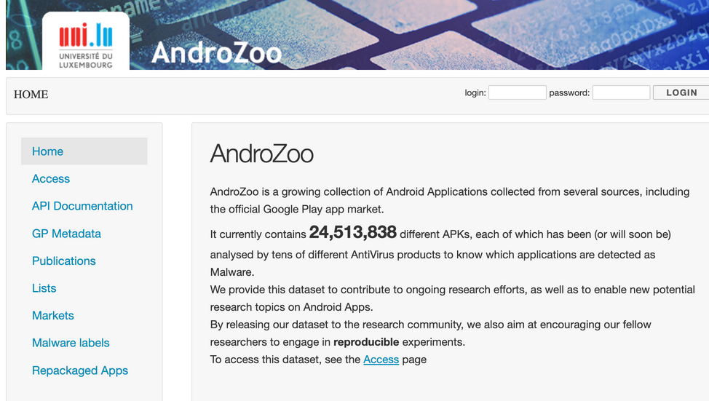
Creating Dataset
Data Sources:
Androzoo: A repository of millions of Android APKs collected from various sources.
Google Play Store: Official and third-party Android markets.
References: Arp et al., 2014​
Preprocessing Tools:
Kirin: For dynamic permission identification and malware behavior analysis.
AppContext: To capture context-aware application behavior.
Massvet: For detecting repackaged applications.
References: Allix et al., 2014
Labeling and Balancing:
Labeling: Samples labeled as benign or malicious based on known datasets such as Drebin​​.
Balancing: Ensure balanced datasets to avoid bias in training, using techniques like oversampling and undersampling.

Slide 14
Creating Dataset
Feature Extraction
Reverse Engineering:
Tools: apktool for extracting resources, dex2jar for converting Dalvik bytecode to Java bytecode.
Extracted Features: Smali code sequences, API call sequences, permissions, and intent filters.
References: McLaughlin et al., 2017​​.
Static Analysis:
Permissions Analysis: Extract permissions from AndroidManifest.xml.
API Calls: Analyze sequences of API calls used by the application.
References: Yadav et al., 2017
A single feature cannot fully represent malware. For example, grayscale images can only represent the outline of malware, and API call graphs can only represent the control structure of malware. However, opcodes exist in most software
-Longhui Shu, 2023

Slide 15
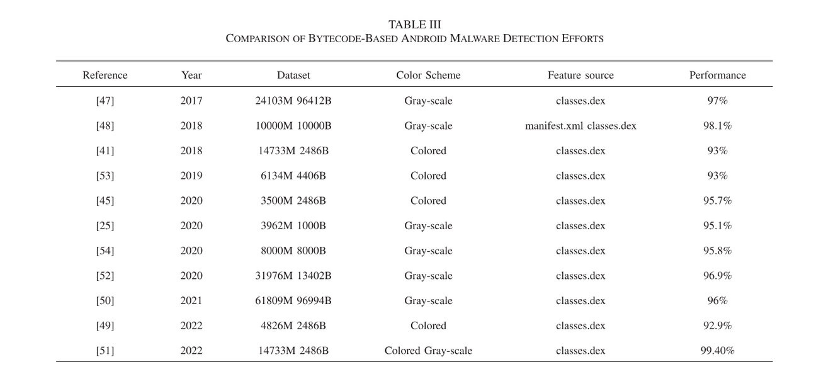
Bytecode-Based Detection
Conversion Process:
Bytecode sequences from the classes.dex file are converted to image representations.
Hexadecimal bytecode values are mapped to grayscale (0-255) or RGB values.
CNN Application:
Images are fed into a CNN architecture for feature extraction and classification.

Slide 16
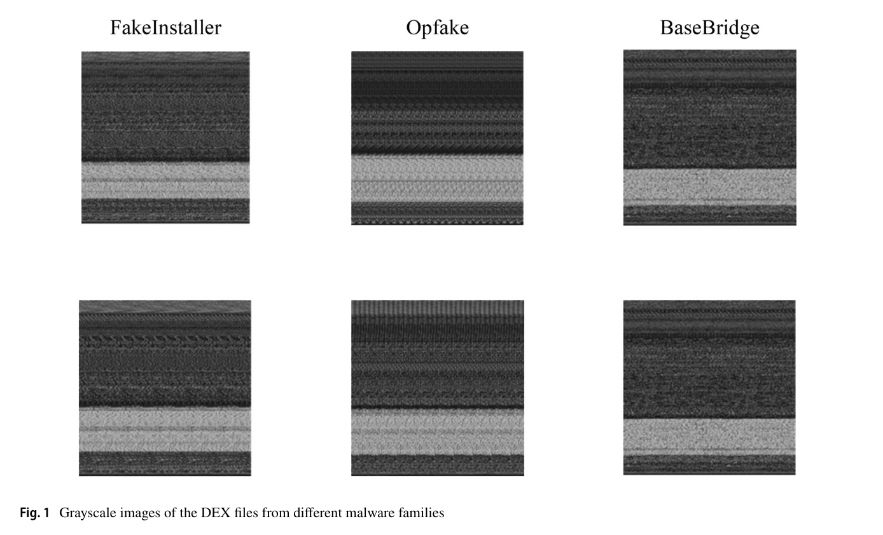
Bytecode-Based Detection
Key Studies:
Huang et al. (2017): Developed R2-D2, converting bytecode to RGB images, achieving high detection accuracy without feature engineering.
Yadav et al. (2017): Used one-hot encoding of bytecode sequences for CNN input, improving robustness against obfuscation.
Xiao et al. (2018): Demonstrated effectiveness against code obfuscation by converting bytecode to RGB images and using CNNs for classification.
Ding et al. (2020) demonstrated high detection accuracy using this approach by converting bytecode to images and leveraging CNNs to recognize visual patterns consistent with malware.
Ding et al. (2020)

Slide 17
Permission-Based Detection
Feature Extraction:
Permissions declared in the androidmanifest.xml file are extracted and encoded.
Features are represented as 2D matrices or images.
CNN Application:
Permission matrices or images are processed by CNNs to detect malicious patterns.

Slide 18
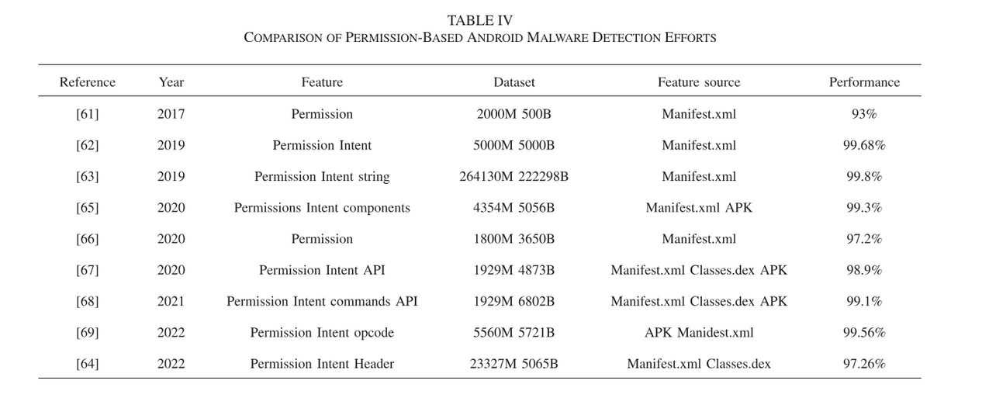
Permission-Based Detection
Key Studies:
Ganesh et al. (2018): Converted permissions into 2D matrices for CNN input, showing fast and efficient detection.
Lee et al. (2019): Combined RNN and CNN to create a lightweight, obfuscation-resistant detection model.
Hojjatnia et al. (2019): Used permission-based images for CNN classification, achieving high detection rates.

Slide 19
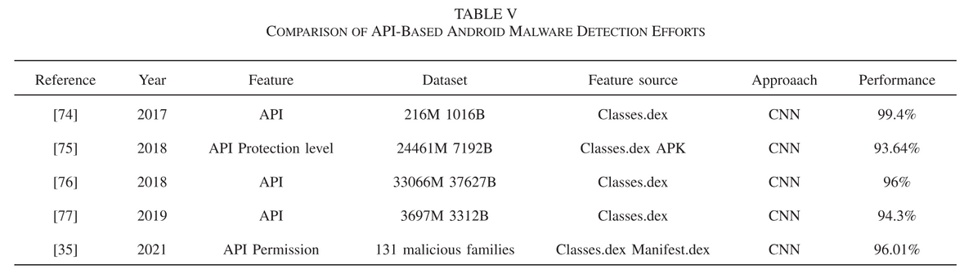
API-Based Detection
Feature Extraction:
Sequences of API calls are extracted from the application's execution or static analysis.
Sequences are encoded into numerical vectors or images.
CNN Application:
API call vectors or images are processed by CNNs to identify malicious behaviors.

Slide 20
API-Based Detection
Key Studies:
Zhang et al. (2018): Visualized API call sequences as images, combining with CNNs for effective classification.
Karbab et al. (2019): Used word2vec for API sequences, converting them into embeddings for CNN processing.
Yeh et al. (2020): Inserted monitoring functions in APKs to dynamically record API calls, using CNNs for analysis.

Slide 21
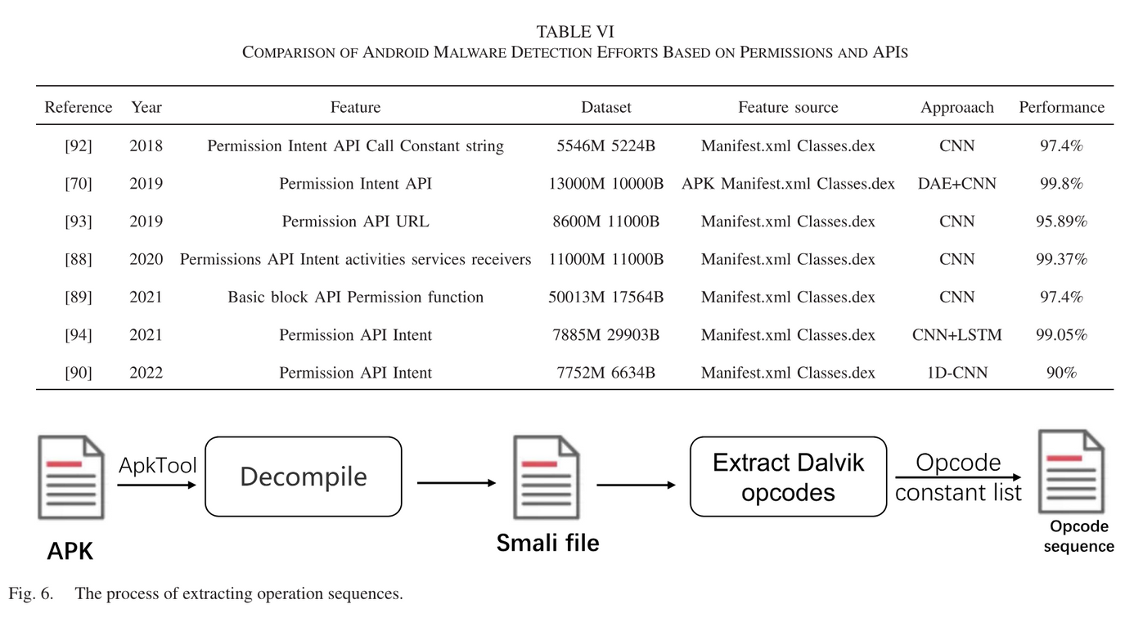
OpCode-Based Detection
Feature Extraction:
Opcode sequences are obtained by disassembling the application.
Operands are discarded, focusing on the opcode instructions.
CNN Application:
Opcode sequences are encoded using one-hot or word embeddings and processed by CNNs.

Slide 22
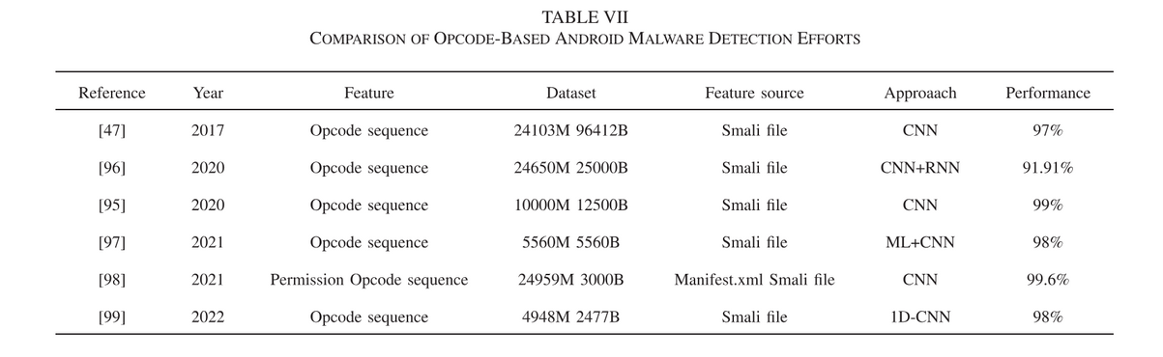
OpCode-Based Detection
Key Studies:
Li et al. (2017): Applied k-max pooling in CNNs for opcode sequence analysis, enhancing robustness against obfuscation.
Kinkead et al. (2018): Combined CNN with LIME for interpretable opcode-based detection.
Wu et al. (2019): Utilized 1D CNNs for opcode sequences, addressing overfitting and obfuscation challenges.

Slide 23
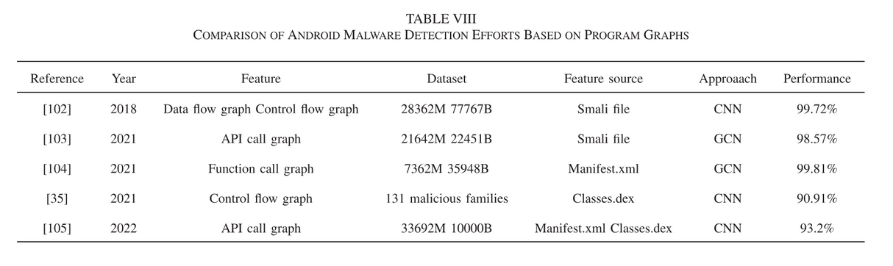
Program Graph-Based Detection
Feature Extraction:
Control flow graphs (CFGs) and data flow graphs (DFGs) are extracted from the application.
Nodes represent operations, and edges represent data or control flow.
Graph Convolutional Networks (GCN):
GCNs are used to process graph-structured data, learning node embeddings for detection.

Slide 24
Program Graph-Based Detection
Key Studies:
Cai et al. (2020): Proposed enhanced function call graphs (E-FCGs) for behavior-level feature learning with GCNs.
Song et al. (2020): Developed a lightweight graph embedding model for detecting obfuscated malware variants.
Zhang et al. (2021): Used CFGs and GCNs to extract high-level features for malware detection.

Slide 25
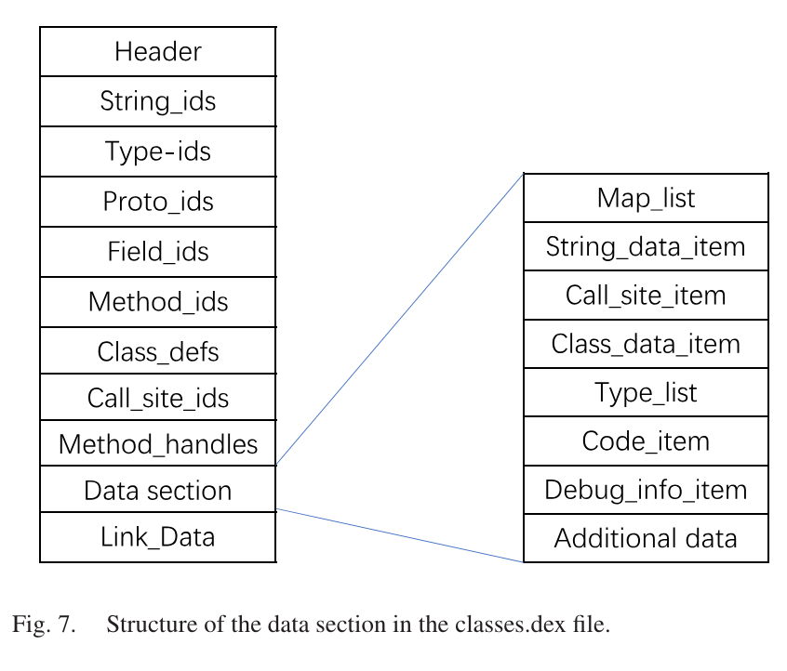
Data Segment-Based Detection
Feature Extraction:
Focus on the data section of the classes.dex file, reducing computational overhead.
Data segments are converted to image representations.
CNN Application:
Images derived from data segments are processed by CNNs for classification.

Slide 26
Data Segment-Based Detection
Key Studies:
Jung et al. (2019): Reduced data volume by focusing on the data section, improving detection accuracy.
Kim et al. (2020): Combined data segments with androidmanifest.xml for enhanced family classification.
Zhang et al. (2021): Used visual features of the androidmanifest.xml and data segments for robust detection.

Slide 27
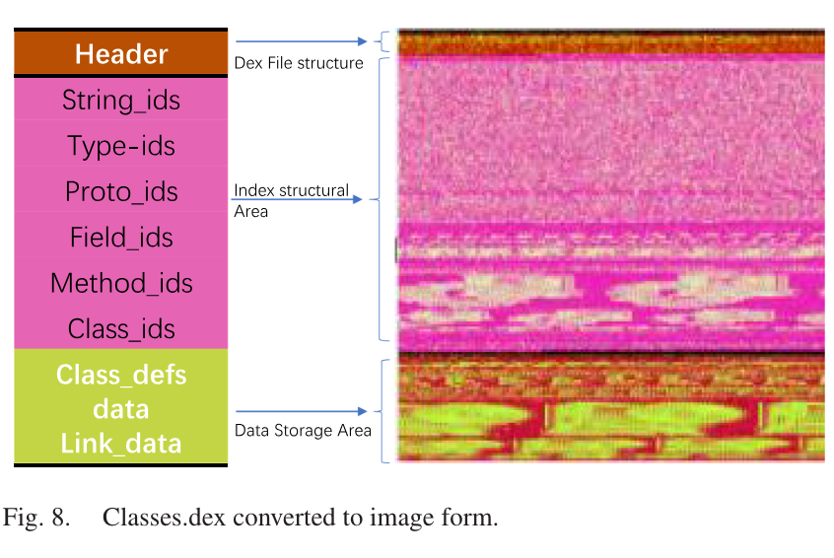
Combined Feature-Based Detection
Feature Fusion:
Integrate multiple features (permissions, APIs, opcodes) into a single representation.
Features are mapped to different channels in RGB images or combined into matrices.
CNN Application:
Fused feature representations are processed by CNNs to capture comprehensive patterns.

Slide 28
Combined Feature-Based Detection
Key Studies:
Darwaish et al. (2019): Mapped permissions, APIs, and opcodes to RGB channels, utilizing CNNs for comprehensive detection.
Chen et al. (2020): Combined basic block, permissions, APIs, and critical functions for CNN-based classification.
Wang et al. (2021): Used hybrid models (CNN + LSTM) to fuse static and dynamic features, improving detection accuracy.

Slide 29
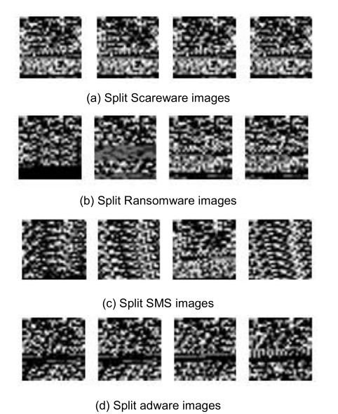
Network-Based Detection
Analyzing network traffic
Packets turns into images
CNN Application:
Packets turns into images after some preprocessing
Key Studies:
Feng et al. (2020)

Slide 30
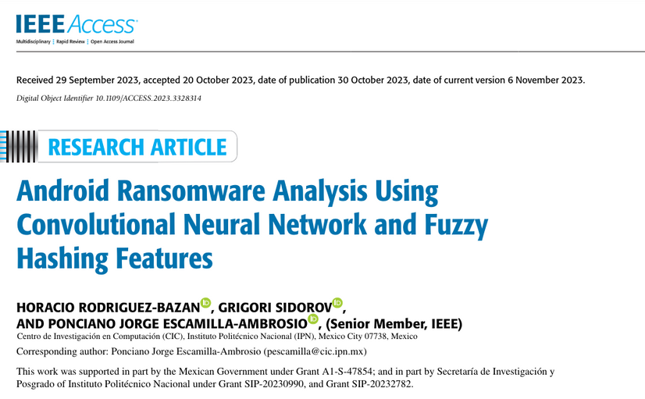

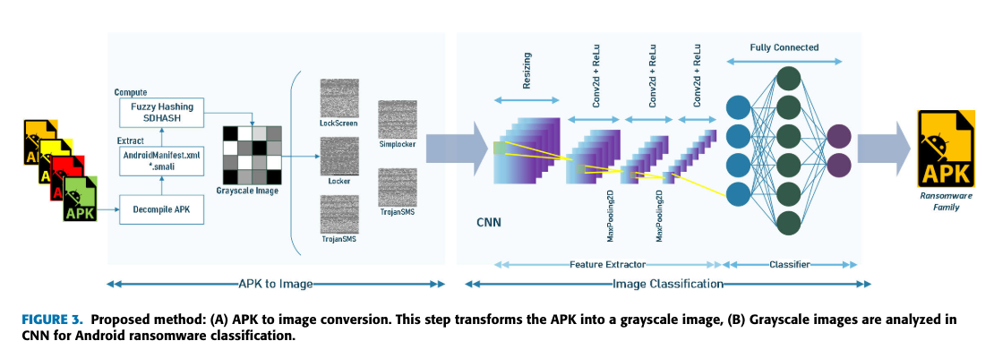
INTERESTING WORK:
ANOTHER APPROACH
https://ieeexplore.ieee.org/stamp/stamp.jsp?tp=&arnumber=10299644

Slide 31

Challenges
Obfuscation
Large-Scale Datasets
Robust Feature Extraction
Effective training of CNN models requires large, diverse datasets.
Collecting and annotating these datasets is time-consuming and labor-intensive.
Over 80% of malware employs obfuscation to evade detection.
Obfuscation techniques include polymorphism, code encryption, and repackaging, making detection difficult.
Extracting robust and discriminative features from malware is crucial for accurate detection.
Current methods may lose critical information during feature extraction.

Slide 32

Challenges
Multi-Level Detection Mechanisms
Robust Models
Single-level detection mechanisms may not be sufficient to detect sophisticated malware.
Existing methods often rely on either static or dynamic analysis alone.
Models must generalize well to new, unseen malware variants.
Overfitting to training data can reduce model effectiveness on real-world data.

Slide 33

Summary
Importance of CNNs in AMD:
CNNs have shown significant potential in improving the accuracy and efficiency of malware detection.
Their ability to process raw data and automatically extract features makes them suitable for AMD.
Need for Continuous Research:
As malware techniques evolve, continuous research and innovation are necessary.
Researchers must focus on developing models that can adapt to new threats and improve over time.

Slide 34

Comprehensive Approach:
Effective AMD requires a comprehensive approach combining multiple features and analysis methods.
Integrating static, dynamic, and hybrid analyses can provide better detection capabilities.
Collaboration and Data Sharing:
Collaboration within the research community and sharing large-scale datasets can accelerate advancements.
Open datasets and shared resources can help in training more robust models.

Slide 35
Future Research Directions
Innovation and Adaptation:
Future research should focus on developing innovative techniques to counteract obfuscation and other evasion tactics.
Adaptive models that continuously learn and evolve with new data are crucial.
Multi-Level and Multi-Modal Analysis:
Combining multi-level detection mechanisms and leveraging multi-modal data can enhance detection robustness.
Exploring new data sources and integrating diverse feature sets will be key.
Final Thoughts
Continuous Improvement:
The fight against Android malware is ongoing, requiring constant vigilance and improvement.
By leveraging advanced technologies like CNNs and fostering collaboration, the research community can make significant strides in protecting users from malware threats.

Slide 36
REFERENCES
1. Android Malware Detection Methods Based on Convolutional Neural Network: A Survey Shu, L., Dong, S., Su, H., & Huang, J. (2023). IEEE Transactions on Emerging Topics in Computational Intelligence.
2. Android Ransomware Analysis Using Convolutional Neural Network and Fuzzy Hashing Features
3. Android Malware Detection Method Based on Bytecode Image Ding, G., Liu, J., Hu, Z., & Zhang, D. (2020). Proceedings of the IEEE International Conference on Big Data (Big Data).
4. Towards Explainable CNNs for Android Malware Detection Kinkead, D., Zhang, S., Ma, J., & Sun, Q. (2021). Proceedings of the IEEE International Conference on Cyber Security and Resilience (CSR).
5. Arp, D., Spreitzenbarth, M., Hubner, M., Gascon, H., Rieck, K., & Siemens, C. (2014). Drebin: Effective and Explainable Detection of Android Malware in Your Pocket. In *Proceedings of the Network and Distributed System Security Symposium (NDSS)*.
6. Allix, K., Bissyandé, T. F., Klein, J., & Le Traon, Y. (2014). MassVet: Vetting Android Apps for Malicious Behavior. In *Proceedings of the 22nd ACM SIGSAC Conference on Computer and Communications Security (CCS)*.
7. Huang, H., Song, Y., Liu, H., & Ye, Y. (2017). R2-D2: Color-Inspired Convolutional Neural Network (CNN)-based Android Malware Detection. In *Proceedings of the ACM International Conference on Information and Knowledge Management (CIKM)*.
8. Yadav, T., Rao, A. M., & Srinivas, K. (2017). Android Malware Detection Using Deep Learning on API Method Sequences. In *Proceedings of the International Joint Conference on Neural Networks (IJCNN)*.
9. Xiao, F., Zhang, Z., & Gu, G. (2018). Android Malware Detection Using Deep Learning. *IEEE Access*, 6, 12825-12833.
10. Ding, G., Liu, J., Hu, Z., & Zhang, D. (2020). Android Malware Detection Method Based on Bytecode Image. In *Proceedings of the IEEE International Conference on Big Data (Big Data)*.
11. Ganesh, N., Mathew, J., & Jose, A. (2018). Permission-Based Android Malware Detection Using Deep Learning. In *Proceedings of the International Conference on Computer Communication and Informatics (ICCCI)*.
12. Lee, K., Lee, J., & Lee, H. (2019). Lightweight Permission-Based Android Malware Detection Model Using Convolutional Neural Network. *Journal of Information Security and Applications*, 44, 76-83.
13. Hojjatnia, A., Azmoodeh, A., Dehghantanha, A., & Karimipour, H. (2019). Permission-Based Android Malware Detection Using Convolutional Neural Network. *Computers & Security*, 89, 101682.
14. Zhang, Y., Wang, W., & Sun, Y. (2018). API Call Sequence Based Android Malware Detection Using CNN. *IEEE Access*, 6, 27005-27016.

Slide 37
REFERENCES
15. Karbab, E. B., Derhab, A., Mouheb, D., & Debbabi, M. (2019). MalDozer: Automatic Framework for Android Malware Detection Using Deep Learning. *Digital Investigation*, 26, S48-S59.
16. Yeh, T. C., Li, J. W., Lai, F. C., & Lee, C. H. (2020). Android Malware Detection through API Call Sequence Analysis Using LSTM. *IEEE Transactions on Information Forensics and Security*, 15, 2039-2050.
17. Li, Z., Li, H., Liu, W., Liu, S., & Wang, H. (2017). k-Max Pooling CNN for Android Malware Classification. *IEEE Access*, 5, 6004-6013.
18. Kinkead, D., Zhang, S., Ma, J., & Sun, Q. (2018). Explainable Convolutional Neural Networks for Malware Classification. In *Proceedings of the ACM SIGKDD Conference on Knowledge Discovery and Data Mining (KDD)*.
19. Wu, C., Liu, H., & Li, Y. (2019). Opcode Sequence Based Android Malware Detection Using Convolutional Neural Networks. *Journal of Information Security and Applications*, 47, 42-51.
20. Cai, Z., Luo, X., & Xu, X. (2020). Enhanced Function Call Graphs for Behavior-Based Android Malware Detection Using GCN. *IEEE Access*, 8, 128825-128838.
21. Song, H., Zhang, Y., & Shi, W. (2020). Lightweight Graph Embedding for Android Malware Detection. *Computers & Security*, 97, 101942.
22. Zhang, J., Sun, K., Xu, Q., & Zhu, H. (2021). Android Malware Detection Based on Hybrid Graph Convolutional Networks. *IEEE Transactions on Mobile Computing*.
23. Jung, K., Hwang, J., & Park, J. (2019). Data Segment-Based Android Malware Detection Using Convolutional Neural Networks. *IEEE Access*, 7, 77921-77931.
24. Kim, J., Park, J., & Jung, K. (2020). Family Classification of Android Malware Using Data Segments and Convolutional Neural Networks. *Journal of Information Security and Applications*, 53, 102523.
25. Darwaish, A., Al-Khateeb, H., & Buczak, A. L. (2019). Hybrid Deep Learning Approach for Android Malware Detection. *IEEE Access*, 7, 21455-21465.
26. Chen, X., Zhang, H., & Sun, W. (2020). Malware Detection Based on Combination of Multiple Features and CNN. *Journal of Computer Virology and Hacking Techniques*, 16, 301-311.
27. Wang, Z., Du, X., & Dou, W. (2021). A Hybrid CNN-LSTM Model for Android Malware Detection. *IEEE Transactions on Network and Service Management*, 18(3), 3073-3085.
28. Raff, E., Barker, J., Sylvester, J., Brandon, R., Catanzaro, B., & Nicholas, C. K. (2018). Malware Detection by Eating a Whole EXE. In *Proceedings of the AAAI Conference on Artificial Intelligence (AAAI)*.
29. Martinelli, F., Saracino, A., Sgandurra, D., & Shetty, J. (2017). Evaluating Convolutional Neural Networks for Effective Mobile Malware Detection. In *Proceedings of the IEEE International Conference on Cyber Security and Protection of Digital Services (Cyber Security)*.
30. Ribeiro, M. T., Singh, S., & Guestrin, C. (2016). "Why Should I Trust You?" Explaining the Predictions of Any Classifier. In *Proceedings of the ACM SIGKDD International Conference on Knowledge Discovery and Data Mining (KDD)*.
31. Kinkead, D., Zhang, S., Ma, J., & Sun, Q. (2021). Towards Explainable CNNs for Android Malware Detection. In *Proceedings of the IEEE International Conference on Cyber Security and Resilience (CSR)*.

Slide 38
THANK
YOU

